Slide 1
Software Quality Assurance

Slide 2

Project Planning
- Quality Concepts
- Quality
- Quality Control
- Quality Assurance
- Cost of Quality
- Software Quality Assurance
- Software Reviews
- Formal Technical Reviews
- The Review Meeting
- Review Reporting and Record Keeping
- Review Guidelines
- Formal Approaches to SQA
- Statistical Quality Assurance
- Software Reliability
- The SQA Plan

Slide 3

Quality Concepts
Software quality assurance is an umbrella activity that is applied throughout the software process.
SQA encompasses:
i. a quality management approach
ii. effective software engineering technology
iii. formal technical reviews
iv. a multi-tiered testing strategy
v. document change control
vi. software development standard and its control procedure
vii. measurement and reporting mechanism

Slide 4

Quality Concepts
Quality
- refers to measurable characteristics of a software.
These items can be compared based on a given standard
Two types of quality control:
- Quality of design
-> the characteristics that designers specify for an item.
-> includes: requirements, specifications, and the design of the system.
Quality of conformance
-> the degree to which the design specification are followed.
-> It focuses on implementation based on the design.

Slide 5

Quality Control
What is quality control
-- the series of inspections, reviews, and test used throughout the
develop cycle of a software product
Quality control includes a feedback loop to the process.
Objective
---> minimize the produced defects, increase the product quality
Implementation approaches:
- Fully automated
- Entirely manual
- Combination of automated tools and human interactions

Slide 6
Quality Control
Key concept of quality control:
--> compare the work products with the specified and measurable standards
Quality assurance consists of:
- the auditing and reporting
Goal
--> provide management with the necessary data about
product quality.
--> gain the insight and confidence of product quality

Slide 7


Quality Concepts
How do I ensure that
I’ve done the right thing or have I done it right?
Variation control is the heart of quality control.
Minimize the difference between the predicted resources needed to complete a project and the actual resources used, including staff, equipment, and calendar time.
Minimize the number of defects that are released to the field, we’d like to ensure that the variance in the number of bugs is al so minimized from one release to another.
User satisfaction = compliant product + good quality + delivery within budget and schedule

Slide 8





Cost of Quality
Cost of quality --> includes all costs incurred in the pursuit of quality or perform quality related work
Quality cost includes:
Prevention cost:
- quality planning
- formal technical reviews
- testing equipment
- training
- Appraisal cost:
- in-process and inter-process inspection
- equipment calibration and maintenance
- testing
- Failure cost:
internal failure cost:
- rework, repair, and failure mode analysis
external failure cost:
- complaint resolution
- product return and replacement
- help line support
- warranty work

Slide 9


Software Quality Assurance
Goal: to achieve high-quality software product
Quality definition:
“Conformance to explicitly stated functional and performance requirements, explicitly documented development standards, and
implicit characteristics that expected of al professional developed software.”
Three import points for quality measurement:
- Use requirements as the foundation
- Use specified standards as the criteria
- Considering implicit requirements

Slide 10

Software Quality Assurance
About Quality Assurance:
The first formal quality assurance and control function was introduced at
Bell Labs in 1916 in the manufacturing world.
During the 1950s and 1960s, the programmers controlled their product
quality.
During the 1970s, quality assurance standards were introduced first in
military contract software development.

Slide 11

SQA Group
Who involves quality assurance activities?
Software engineers, project managers, customers, sale people, SQA group
Engineers involved in the quality assurance work:
- apply technical methods and measures
- conduct formal technical review
- perform well-planned software testing
The SQA group’s role
- serves as the customer’s in-house representative assist the software engineering team in achieving high-quality
The SQA group’s responsibility:
- quality assurance planning oversight, record keeping, analysis and
reporting

Slide 12

SQA Group
The SQA group’s tasks:
- Prepare a SQA plan for a project
Participate in the development of the project’s software process
description
Review engineering activities to verify compliance with the defined
process
Audits designated software work products to verify compliance in the
defined process
Ensure the deviations in software work and products according to a
documented procedure
- Records any noncompliance and reports to senior management

Slide 13

Software Reviews
What is software reviews?
- a “filter” for the software engineering process.
Purpose:
-serves to uncover errors in analysis, design, coding, and testing.
Why software reviews?
- To err is human
- Easy to catch the errors in engineers’ work
A review --> a way to
- identify the needed improvements of the parts in a product
- confirm the improvement parts of a product.
- achieve technical work of more uniform, predicable, and
manageable.

Slide 14

What Are Reviews?
a meeting conducted by technical people for technical review
a technical assessment of a work product created during the software engineering process
a software quality assurance mechanism
a training ground

Slide 15


What Reviews Are Not
A project summary or progress assessment
A meeting intended solely to impart information
A mechanism for political or personal reprisal!

Slide 16

What Do We Look For?
Errors and Defects
Error
  a quality problem found before the software is released
to end users
Defect
  a quality problem found only after the software has
been released to end-users
Errors and defects have very different economic, business, psychological, and human impact!!

Slide 17

Formal Technical Reviews (FTR)
Objectives of FTR:
- to uncover errors in function, logic, or implementation
to verify the software under review meets its requirements
to ensure that the software has been represented according to
predefined standards
- to develop software in a uniform manner
to make projects more manageable
The FTR is actually a class of reviews that includes walkthroughs and inspections.

Slide 18

Formal Technical Reviews (FTR)
Purposes of FTR:
- serves as a training ground for junior engineers
- promote backup and continuity
Review meeting’s constraints:
- 3-5 people involved in a review
- advanced preparation (no more than 2 hours for each person)
- the duration of the review meeting should be less than 2 hours
- focus on a specific part of a software product
People involved in a review meeting:
- producer, review leader, 2 or 3 reviewers (one of them is recorder)

Slide 19


Formal Technical Reviews (FTR)
The preparation of a review meeting:
- a meeting agenda and schedule (by review leader)
- review material and distribution (by the producer)
- review in advance (by reviewers)
Review meeting results:
- a review issues list
- a simple review summary report (called meeting minutes)
- meeting decisions:
- accept the work product w/o further modification
- reject the work product due to errors
- accept work under conditions (such as change/review)
- sign-off sheet

Slide 20

Formal Technical Reviews (FTR)
Review summary report (a project historical record) answers the following questions:
- what was reviewed?
- who reviewed it?
- what were the findings and conclusions
Review issues list serves two purposes:
- to identify problem areas in the project
- to serve as an action item checklist (a follow-up procedure is needed)

Slide 21

Review Guidelines (for FTR)
A minimum set of guidelines for FTR:
- Review the product, not the producer
- Set an agenda and maintain it
- Limit debate and rebuttal
- Enunciate problem areas, but don’t attempt to solve every problem noted
- Take written notes
- Limit the number of participants and insist upon advance preparation
- Develop a checklist for each work product that is likely to be reviewed
- Allocate resources and time schedule for FTRs
- Conduct meaningful training for all reviewers
- Review your early reviews

Slide 22

The Players
review
leader
standards bearer (SQA)
producer
maintenance
oracle
recorder
reviewer
user rep

Slide 23


Statistical Quality Assurance
Statistical quality assurance reflects a growing trend throughout industry to become more quantitative about quality.
Statistical quality assurance implies the following steps:
- Information about software defects is collected and categorized
- An attempt is made to trace each defect to its underlying cause
- Once the vital few causes have been identified, correct the defects.

Slide 24

Statistical Quality Assurance
Causes of Errors:
incomplete or erroneous specification (IES)
misinterpretation of customer communication(MCC)
intentional deviation from specification (IDS)
violation of programming standards (VPS)
error in data representation (EDR)
inconsistent module interface (IMI)
error in design logic (EDL)
incomplete or erroneous testing (IET)
inaccurate or incomplete documentation (IID)
error in programming language translation of design (PLT)
ambiguous or inconsistent human-computer interface (HCI)
miscellaneous (MIS)

Slide 25

Statistical Quality Assurance
In conjunction with the collection of defect information, software developers can calculate an error index (EI) for each major step in the software engineering process.
(It develops an overall indication of improvement in software quality.)
The following data are collected:
E_{i} = the total no. of errors uncovered during the ith step in the process.
S_{i} = the no. of serious errors
M_{i} = the no. of moderate errors
T_{i} = the no. of minor errors
PS = the size of the product at the ith step.

Slide 26

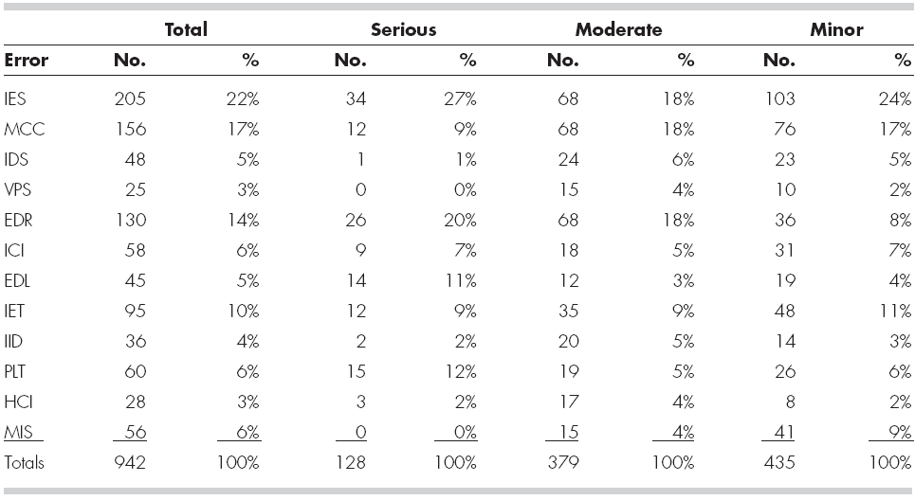
Statistical Quality Assurance

Slide 27
Reliability Metrics
i. Rate of occurrence of failure : Measures the frequency of occurrence of unexpected behavior over a specified time interval
Mean Time to Failure (MTTF): The average time
between two successive failures
Only runtime is considered , time for fixing
error, boot time are ignored

Slide 28
Reliability Metrics
iii. Mean Time to Repair (MTTR): Average time it takes to track error and fix it.
iv. Mean Time Between Failures (MTFB):
MTBF = MTTF + MTTR
MTBF of 300 hours means after a failure the
next failure is expected to occur only after
300 hours

Slide 29
ISO 9000
A series of 3 standards ISO 9001,9002,9003
If proper process is followed for production then good quality products are bound to follow automatically!!

Slide 30
ISO 9000
A quality assurance system may be defined as the organizational structure, responsibilities, procedures, processes, and resources for implementing quality management
Quality assurance systems are created to help organizations ensure their products and services satisfy customer expectations by meeting their specifications.

Slide 31
ISO 9000
These systems cover a variety of activities like planning, controlling, measuring, testing and reporting, and improving quality levels throughout the development and manufacturing process.
After adopting the standards, a country typically permits only ISO registered companies to supply goods and services to government agencies and public utilities.

Slide 32
ISO 9000
To become registered, a company’s quality system and operations are scrutinized(examine closely) by third party auditors for compliance to the standard and for effective operation.
Upon successful registration, a company is issued a certificate from a registration body represented by the auditors.
Semi-annual surveillance audits ensure continued compliance to the standard.

Slide 33
ISO 9000
For a quality system to be ISO compliant, these processes must address the areas identified in the standard and must be documented and practiced as described.

Slide 34
ISO 9001
Applies to organizations engaged in design, development, production and servicing of goods
Applicable to most software development organizations

Slide 35
ISO 9002
Applies to organizations which do not design products but are only involved in production
e.g. steel and car manufacturing industries (they buy plant and product design from others)

Slide 36
ISO 9003
Applies to organizations involved only in installation and testing of products

Slide 37
Why get ISO 9000 Certification?
Increase of confidence of customers in an organization
It requires well documented software production process (repeatable and higher quality )
Points out weak points of an organizations

Slide 38
How to get ISO 9000 Certification
Application Pre-assessment
Document Review
Compliance Audit
Registration
Surveillance

